Slide 1
MSDL Version 1
Rational & Overview
Presentation
Jeff Abbott
DG Co-Editor
June 20th, 2007

Slide 2
Overview
The following brief outlines the rationale for MSDL Drafting Group decisions leading to the candidate version 1 specification and schema for MSDL.
The primary objective was to provide the foundation of MSDL for integration of JC3IEDM, C-BML, and extensions to MSDL on a defined and deliberate schedule.
This is an important “First Step” forward.

Slide 3
Topic Areas
DG History
  The road to balloting
BOM Alignment
  Base Object Model
JC3IEDM Alignment
  Forces & Sides, Weather
Changes and Additions to Content
  Schema and content
Deleted or Removed Content
  Out of Scope, High Risk,
Actions Remaining
  Complete actions leading to balloting

Slide 4
DG Member List – 17
(the road to balloting)
Name | Position | Organization
Abbott , Jeff | DG Editor | OneSAF/AcuSoft; United States
Bowers, Andy | Member | JFCOM/MITRE; United States
Chase, Tram | Member | Simventions; United States
Covelli, Javier (Jeff) | Member | CTIA/General Dynamics; United States
Fraka, Mike | Member | U.S. Army TRADOC Analysis Center; United States
Gagnon , François | Member | CAE, Products & Technologies; Canada
Giguere, Ghislain | Member | CAE, Products & Technologies; Canada
Gupton, Kevin | Member | ARL-UT; United States
Gustavsson, Per | Member | SAAB; Sweden
Knight, Sam | Member | TBD
Levine, Stanley | Member | C-BML/GMU; United States
Loftus, Beth | Member | MATREX/MITRE; United States
Peplow, Ken | Secretary | OneSAF/SAIC; United States
Prochnow, Dave | Member | MATREX/MITRE; United States
Sornatale, Stephanie | Member | SE-Core/SAIC; United States
Turnitsa, Chuck | Member | C-BML/Old Dominion University; United States
Wittman , Rob | Vice Chair | OneSAF/MITRE; United States

Slide 5

DG Process
(the road to balloting)
DG Process Documents (posted to file area)
  MSDL DG Product Development Plan
  MSDL DAR Process
  MSDL DG PCR Process
  MSDL DG Peer Review Process & Review Guidelines
  MSDL DG Commend and Resolution Process
  MSDL XML Coding Conventions
DG Templates
  PCR Template
  Comment & Defect Template
  DAR Template
Share Point Portal (MITRE)
Shared Processes provide:
Common Language
Common Process for the work (vs. Work Products)
Provides Monitoring and Control over development efforts
Establishes expectations over schedule & development

Slide 6
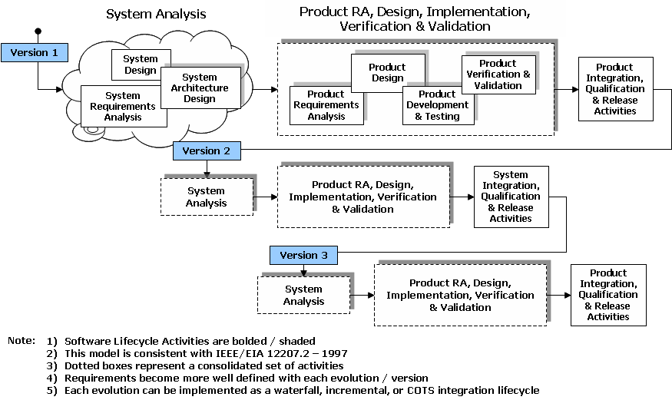
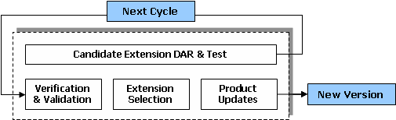
MSDL Product Development Plan
What we are doing
How we are doing it

Slide 7
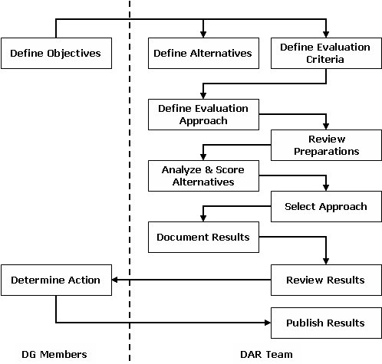
DAR Studies – Complete
(the road to balloting)
Decision Analysis and Resolution Studies for the SG version (posted to file area)
  Forces & Sides
    14 defects all resolved
  Task Organizations
    20 defects all resolved)
  Overlays
    1 defect resolved
  Tactical Graphics
    6 defects all resolved
  Environment
    6 defects all resolved
  Installations
    1 defect resolved
  Military Operations Other Than War
    6 defects all resolved

Slide 8
DAR Studies – Future
(the road to balloting)
Decision Analysis and Resolution Studies Deferred (Future)
  Threats (COE)
    SG Version
    Postponed for JC3IEDM alignment
  Plan and Course of Action
    SG Version
    Postponed for C-BML alignment
  Effects Guidance
    MATREX Extensions for the Targeting Process
  JC3IEDM Alignment (long term)
    Objective is to align the entire MSDL schema

Slide 9
Tiger Teams
(the road to balloting)
JC3IEDM (François Gagnon)
  Identified overlaps with MSDL
  Resulted in short term alignment for Version 1
  Provides a path forward for additional DARs
BOM (Tram Chase)
  Resulted in the inclusion of BOM meta data schema elements
  Provides a path forward for additional DARs

Slide 10
Action Items
(the road to balloting)
Action-V0-001 Forces and Sides alignment with JC3IEDM
  Align Force Side element with JC3IEDM Organization Type
Action-V0-002 Align environment with JC3IEDM
  Align general/global weather with JC3IEDM weather. This is related to PCR-V0-15/31.
Action-V0-003 Resolve plan content beyond COA
  Need to resolve how what to do with the plan detail beyond COA (OPORD summary, Objectives, Referenced Documents, etc).
Action-V0-004 Add the MSDL namespace to the schema
  MSDL does not have a published namespace. That namespace should conform with the SOSO XML Style Guide. Without a namespace, MSDL cannot be reused in context to their XML efforts.
Action Items:
Result from DG Problem Change Requests
Result from DG Tiger Team Efforts

Slide 11
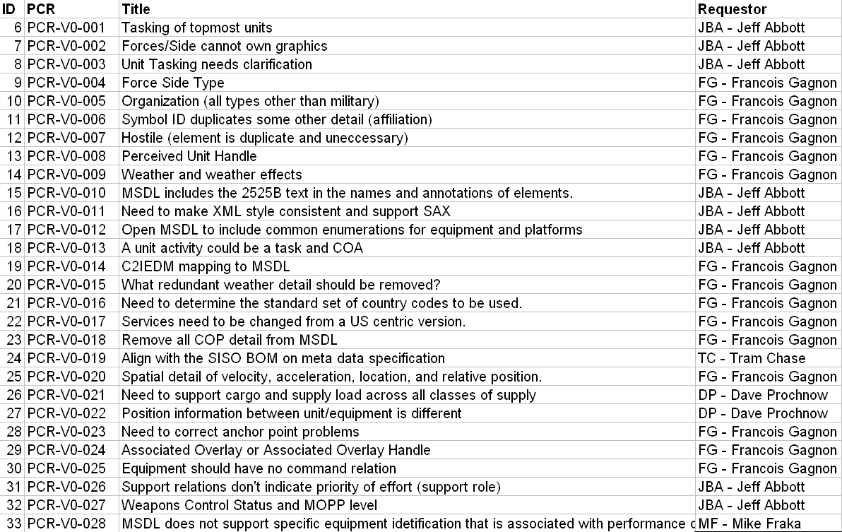
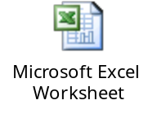
DG PCRs (45)
(the road to balloting)

Slide 12
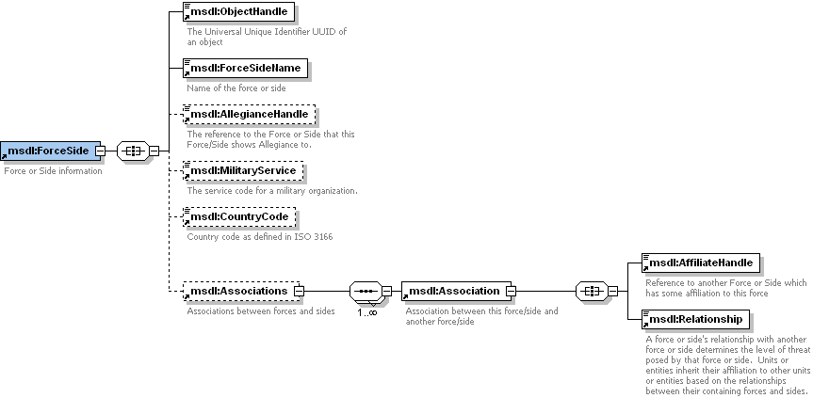
JC3IEDM Alignment
MSDL Version 1 Cont’d
  Forces and Sides
    Applied JC3IEDM simple types (codes) to the existing MSDL elements of forces and sides.
MilitaryOrganisationTypeServiceCode
AffiliationGeopoliticalCode
ObjectItemHostilityStatusCode

Slide 13
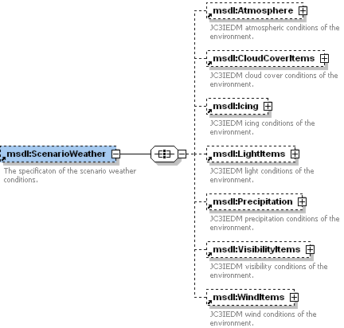
JC3IEDM Alignment
MSDL Version 1
  Weather
    Applied JC3IEDM complex types for weather items including:
      Atmosphere
      Cloud Cover
      Icing
      Light Items (multiple)
      Precipitation
      Visibility Items (multiple)
      Wind Items (multiple)

Slide 14
JC3IEDM Alignment
MSDL Version X (Future)
  All JC3IEDM simple/complex types will be reviewed for inclusion
    JC3IEDM simple types to be applied to existing elements
    JC3IEDM complex types to replace existing elements
    Scope and schedule is TBD and will be driven by our stakeholders to include C-BML.

Slide 15
Changes and Additions
XML Schema Style
  Alignment to the Style Guide
Enumerated Choices
  Some choices were inconsistent with the guide lines
Ownership
  Added to equipment, tactical graphics, MOOTW, and Installations (Force/Side or Unit)
Disposition and Formation
  Consolidated position, speed, direction of movement, etc
Other Tracks (beyond ground)
  Extended organizations to apply beyond ground units
Environment
  Area of Interest and weather

Slide 16
XML Schema Style
Simple Types
  All simple elements have their types defined globally
    Separates the logical data from the physical model
Complex Types
  All complex elements have their types defined globally
    Establishes a common logical re-useable structure
Keys and Key References
  Removed due to poor and conflicting standards support in parser implementations
    Object Handle Keys and Key References
Namespaces
  Usage for MSDL standard
    MSDL and other namespaces are explicit
Enumerated Choices
  Choice is specified in an enumeration
    Owner, Formation, Anchor, Classes of Symbol Modifiers, etc

Slide 17
Deleted or Removed
From Version 1
Unit/Equipment Enumerations
  Removed in preparation of JC3IEDM alignment
COA/Plan
  Removed in preparation of C-BML alignment
Threats
  Removed in preparation of JC3IEDM alignment
Display Only Elements
  No functional representation to simulation
Model Elements and Judgment Information
  Model data belongs with the simulation
  Judgment information is ambiguous (credibility, anticipated status)

Slide 18
DG Actions Remaining
MSDL DG Process Document Update
  Share Point Details
  General Review and Update
MSDL V1 Rationale Document
  Develop based on this presentation
MSDL V1 Technical Specification
  Comment and Defect Incorporation (Second Round)
Final Posting
  Products
  DG Artifacts

Slide 19
PDG/DG Actions Remaining
Complete PDG Review
  ? weeks for review (comment) using SISO tools
  ? weeks for comment integration
  ? week for QA check/verification
Vote to proceed with SAC review for:
  Rules and Guidelines
  Technical Specification & Schema
    Will have final PDG comments incorporated

Slide 20
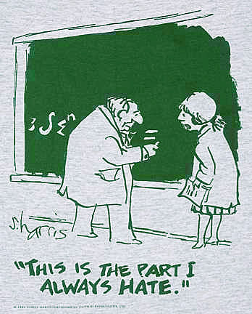
Questions?

